Slide 1
Time series forecasting using symbolic approach
Project (ML for Time Series) - MVA 2022/2023
CHAUVIN Paul
POURCEL Julien

Slide 2
1. Introduction and contribution
Time series forecasting is crucial for many applications, and traditional statistical methods and machine learning models are often used.
Recurrent neural networks (RNNs) are commonly used for time series forecasting but have limitations such as long training times and sensitivity to hyperparameters. [2]
ABBA-LSTM [6] is a hybrid algorithm that combines the ABBA symbolic representation and LSTM neural network architecture to reduce training time and sensitivity to hyperparameters.
This project aims to reproduce and extend the results of the ABBA-LSTM paper, implementing the model and evaluating its performance on various time series datasets.
The contributions of the project will demonstrate the effectiveness of ABBA-LSTM and identify potential ways to improve the model, including modifying the LSTM architecture and applying the method to novel datasets.

Slide 3
2.1. Method - ABBA representation
Symbolic representation is a popular approach for analyzing time series data, involving converting numerical data into a sequence of symbols from a finite alphabet.
The ABBA method [5] is an approach to symbolic representation that involves two stages: compression and digitization.
In the compression stage, an adaptive piecewise linear approximation is constructed, resulting in a polygonal chain that represents the time series with fewer points.
In the digitization stage, the tuples resulting from the compression stage are grouped into clusters, and each cluster is assigned a symbol.
Converting back to a numerical representation requires three stages: inverse-digitization, quantization, and inverse-compression.

Slide 4
2.2. Method - RNN
Combining the ABBA symbolic representation with LSTM architecture can potentially create a more efficient and effective time series forecasting model.
LSTM networks [7] are powerful but slow to train and sensitive to hyperparameters, which can be addressed by using the ABBA symbolic representation.
Gated recurrent unit (GRU) networks have shown promising results in time series forecasting and may be worth exploring in combination with ABBA. [3]
GRU networks have fewer parameters than LSTM networks, making them easier to train and less prone to overfitting.
Comparing the performance of LSTM and GRU networks in combination with ABBA can help identify the best architecture for time series forecasting. [1]

Slide 5
2.3. Method - Data
The UCR dataset [4] is a popular benchmark dataset for time series analysis, consisting of a large number of time series datasets with varying characteristics.
We created 2 types of datasets (“small” and “medium”). The first n values were used to train our models (where n=800 or n=1200), while we used the 200 following values for testing.
We implemented a normalization step, which is a common preprocessing step for time series data that can help improve the performance of deep learning models by making the data more consistent across different datasets.

Slide 6
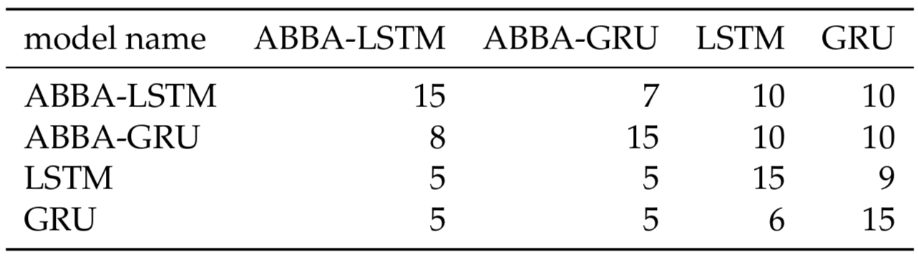
2.4. Method - Experiments
Selection of datasets of the UCR datasets
We compared four models for time series forecasting: ordinary LSTM, ordinary GRU, ABBA-LSTM, and ABBA-GRU.
For each model, we used a context size of 40 (ordinary LSTM and GRU) or 5 (ABBA-LSTM and ABBA-GRU).
We trained all models for 150 epochs with AdamW optimizer and tested them on two sets of datasets: "medium" (1200 training values) and "small" (800 training values).
Regarding the “small” datasets, the table summarizing the results showed that ABBA-GRU and ABBA-LSTM models performed equally well, and ordinary LSTM and GRU models outperformed both ABBA models.
Number of times each model outperformed others on the MSE metric on “small” datasets

Slide 7
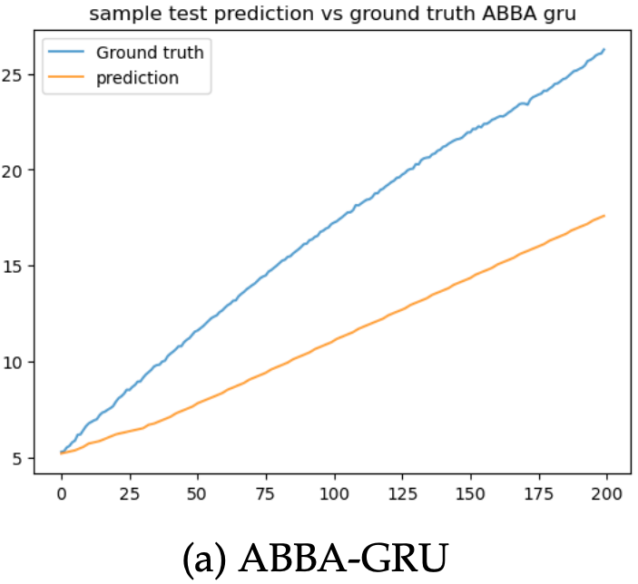
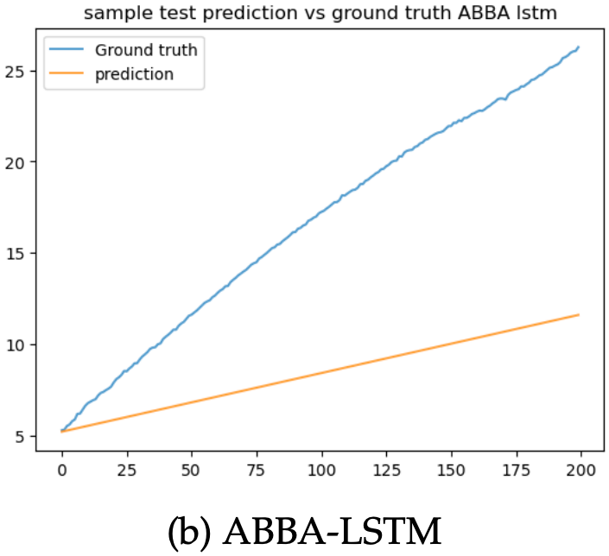
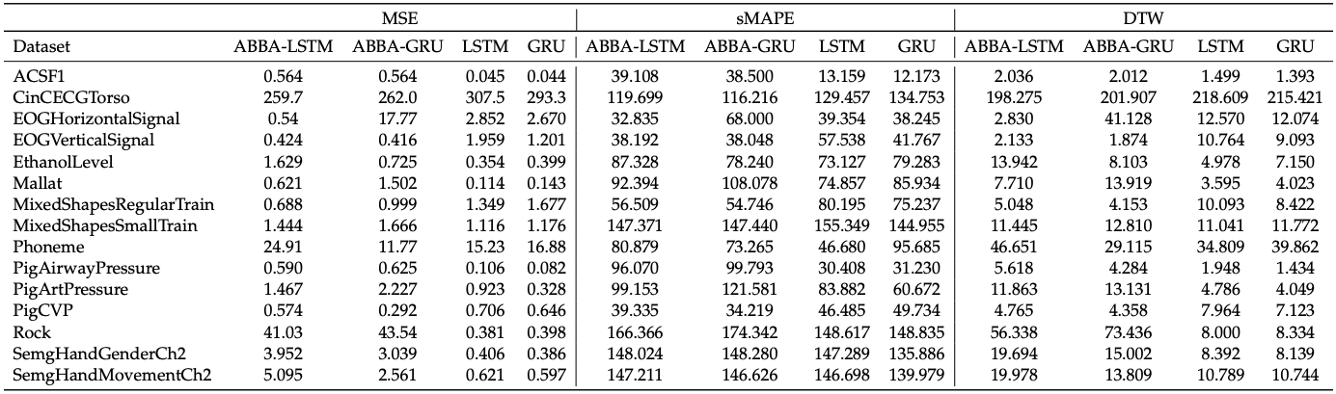
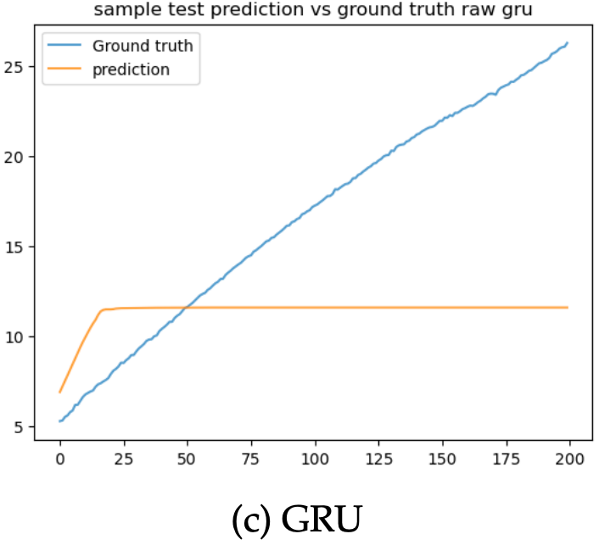
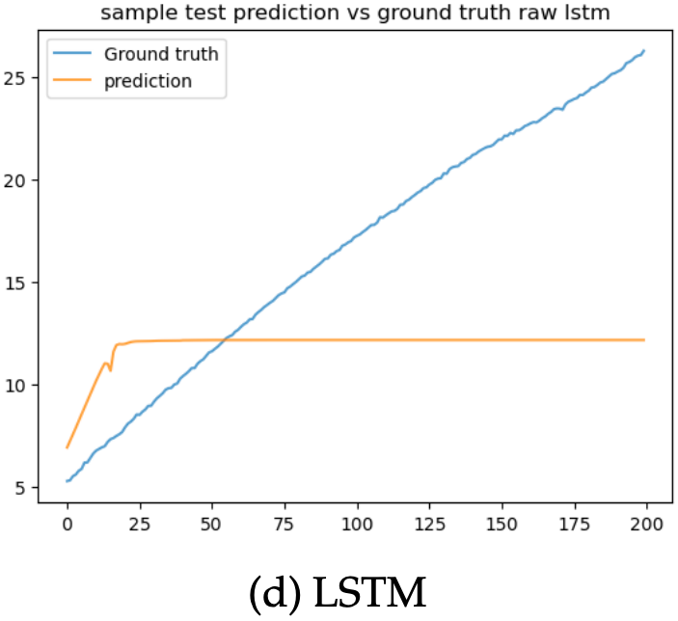
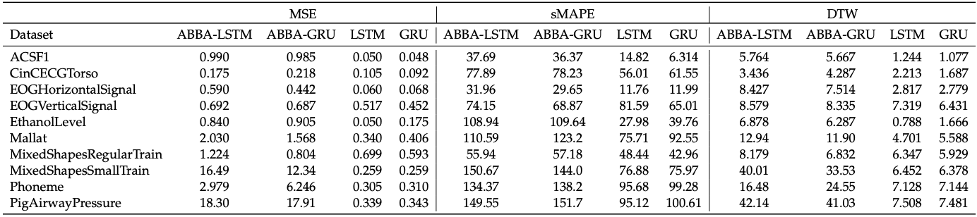
3. Results - Qualitative and Quantitative
Results on “small” datasets
Prediction of our model on PigAirwayPressure small dataset
Results on “medium” datasets
Standard LSTM and GRU models consistently outperformed ABBA models on all datasets in the "medium" dataset setting => Original RNN models have better scaling in terms of data than ABBA models.
ABBA-LSTM model demonstrates the potential to achieve higher accuracy on certain types of time series data compared to traditional LSTM and GRU models, especially with limited data.
Our experiments suggest that the ABBA symbolic representation technique with RNNs architecture may not be suitable for all types of time series data.
Further investigation is needed to determine the effectiveness of ABBA representation technique with other types of neural network architectures.

Slide 8
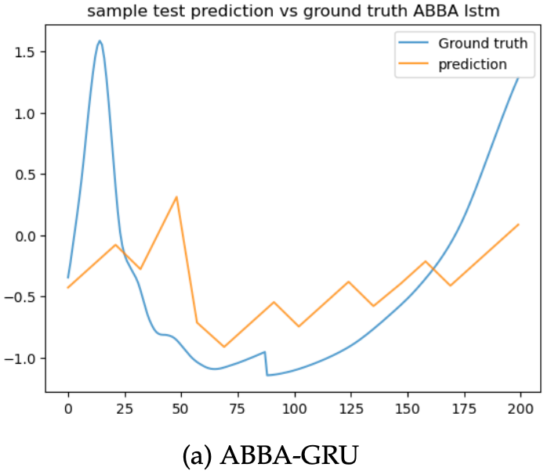
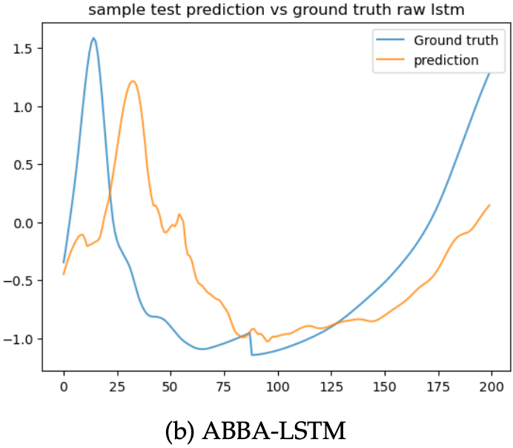
3. Results - Qualitative and Quantitative
Our prediction on the Mallat dataset

Slide 9
4. Conclusion
Our project aimed to reproduce and extend the results of the ABBA-LSTM paper by implementing the ABBA-LSTM model and evaluating its performance on a variety of time series datasets.
Through our own reimplementation of the ABBA-LSTM, we demonstrated the effectiveness of ABBA-LSTM as a method for time series forecasting, with the caveat that we used the official ABBA implementation to transform a times series into a symbolic representation.
Our findings suggest that ABBA-LSTM can be a promising approach to time series forecasting, with potential benefits in terms of reduced training time and improved performance. Further research is needed to explore the full potential of this hybrid algorithm and to identify ways to further improve its effectiveness.

Slide 10
References
[1] Roberto Cahuantzi, Xinye Chen, and Stefan Güttel. A comparison of lstm and gru networks for learning symbolic sequences. arXiv preprint arXiv:2107.02248, 2021.
[2] Kyunghyun Cho, Bart Van Merriënboer, Caglar Gulcehre, Dzmitry Bahdanau, Fethi Bougares, Holger Schwenk, and Yoshua Bengio. Learning phrase representations using rnn encoder-decoder for statistical machine translation. arXiv preprint arXiv:1406.1078, 2014.
[3] Junyoung Chung, Caglar Gulcehre, Kyung Hyun Cho, and Yoshua Bengio. Empirical evaluation of gated recurrent neural networks on sequence modeling. arXiv preprint arXiv:1412.3555, 2014.
[4] Hoang Anh Dau,Anthony Bagnall,Kaveh Kamgar,Chin-Chia Michael Yeh,Yan Zhu,Shaghayegh Gharghabi, Chotirat Ann Ratanamahatana, and Eamonn Keogh. The ucr time series archive. IEEE/CAA Journal of Automatica Sinica, 6(6):1293–1305, 2019.
[5] Steven Elsworth and Stefan Güttel. Abba: Adaptive brownian bridge-based symbolic aggregation of time series. Data Mining and Knowledge Discovery, 34(4):1175–1200, 2020.
[6] Steven Elsworth and Stefan Güttel. Time series forecasting using lstm networks: A symbolic approach. arXiv preprint arXiv:2003.05672, 2020.
[7] Sepp Hochreiter and Jürgen Schmidhuber.Long short-term memory. Neural Computation,9(8):1735–1780, 1997.
[8] Ilya Loshchilov and Frank Hutter. Decoupled weight decay regularization. arXiv preprint arXiv:1711.05101, 2017.

Slide 11
Appendix
Our prediction on the Mallat dataset

